Slide 1

Lab Meeting
Alos Diallo

Slide 2
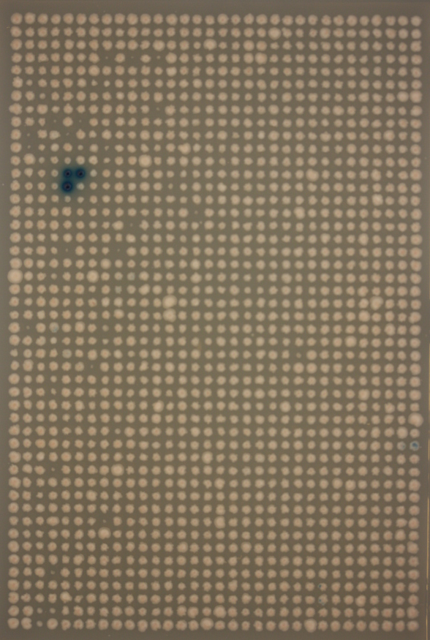
How do we quantitatively analyze Y1H plates
Notes:
How do we analyze the all of the plates that we have to get access to the data they contain

Slide 3
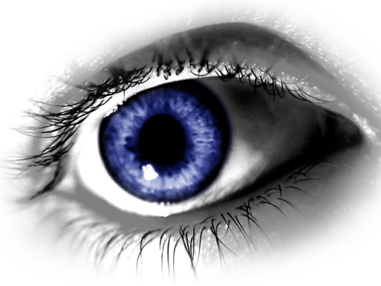

Approaches
Human scoring
Benefits:
-High level of accuracy
Disadvantages:
-It is very time consuming
-Expensive: A biologists time is money
-Subject to bias
Computer scoring
Benefits:
-High speed of quantification
-High level of detail
-Very low end cost
-The ability to improve
-Not subject to personal bias
Disadvantages:
-High initial cost
-Difficult to develop
Notes:
It is subject to plate bias as the yeast is not uniform

Slide 4
The steps in the process
Create the Grid
Produce a list of numerical values that represent the intensity value of a colony as well as the size
Convert the data into a list of which TFs bind to which bait

Slide 5
Creating the grid
Why is the grid important?
The grid provides us with information on what TF is in each colony
The grid allows us store all of the colonies information
Notes:
I have tried numerous methods, but here is the one that worked. Cell profiler was not able to provide the flexibility needed.

Slide 6
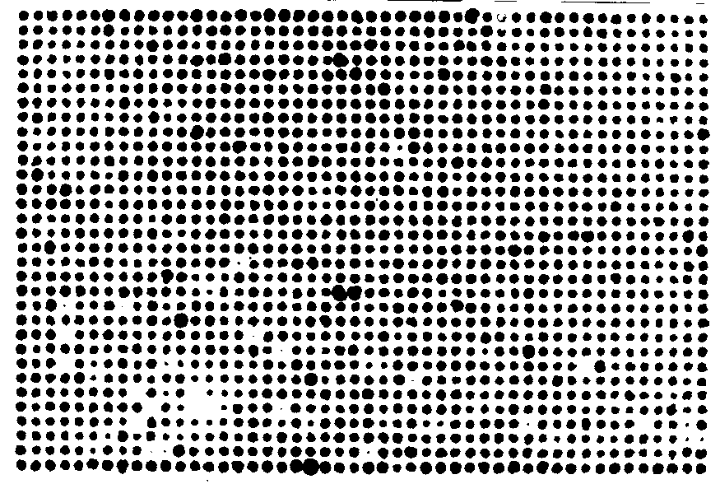
K-means
Find 2 clusters to differentiate background and colonies.
Notes:
Have the original next to the new image

Slide 7
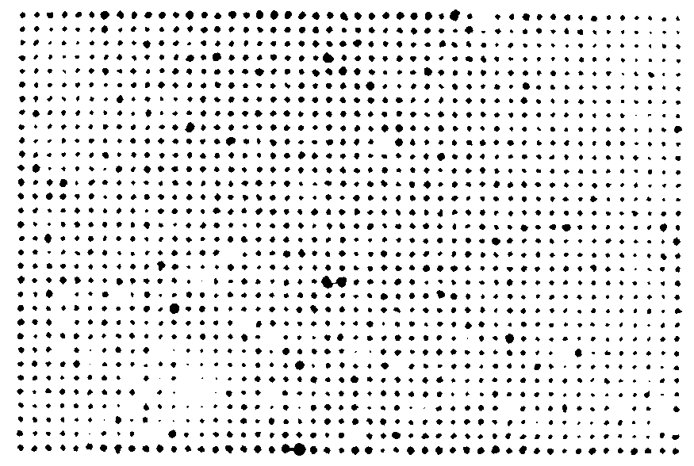
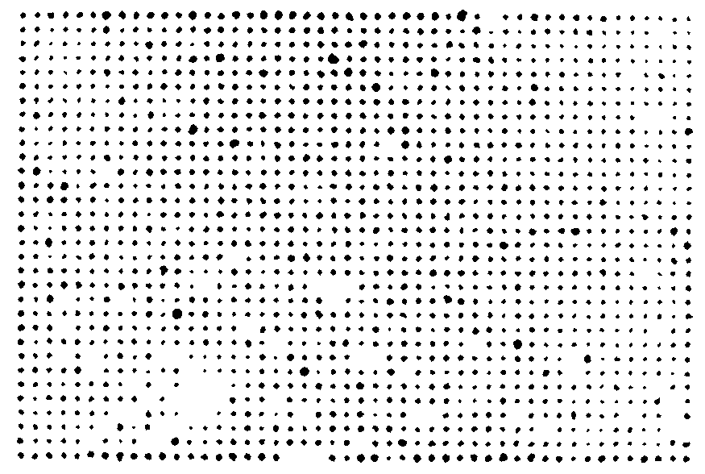
Noise Removal Steps
Original
Step 1:
For every pixel, in each distinct object…look at a NxN box surrounding it.
Radius of 1-2 seems to be good.
Count how many of the neighboring pixel belong to the same object as the reference pixel.
Remove pixels from the ‘object’ that do not contain >= ‘threshold’ neighbors.
This in effect, ‘shrinks’ and circularizes all colonies.
Step 2:
Impose size limitation on all ‘objects’.
Step 1
Step 2

Slide 8

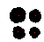
Find the centers of objects

Slide 9
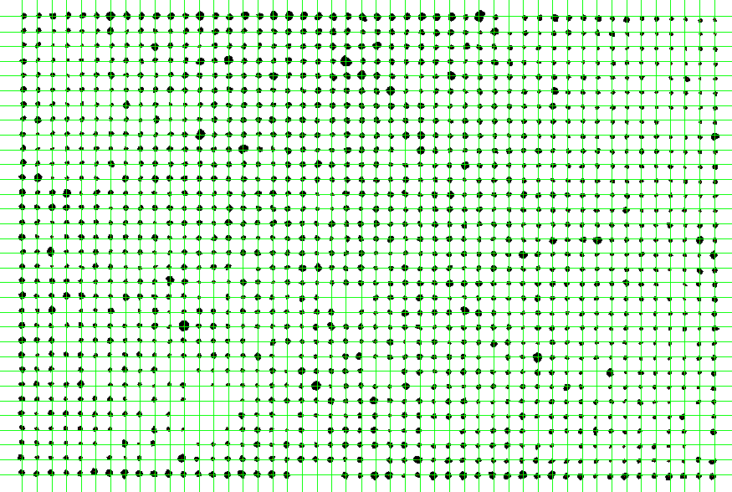
Connect the centers
Notes:
Draw lines connecting the centers

Slide 10
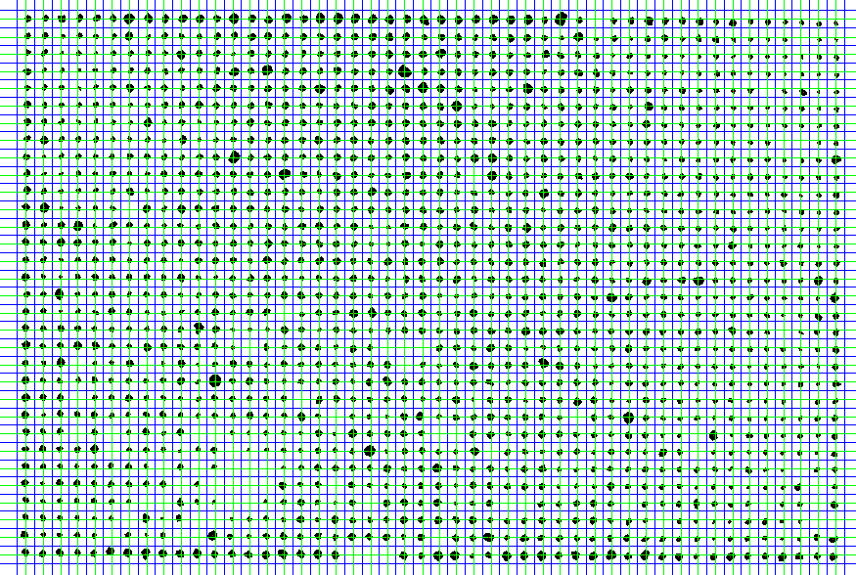
Draw a line through all centers in each group…
Notes:
Draw lines through the center lines

Slide 11
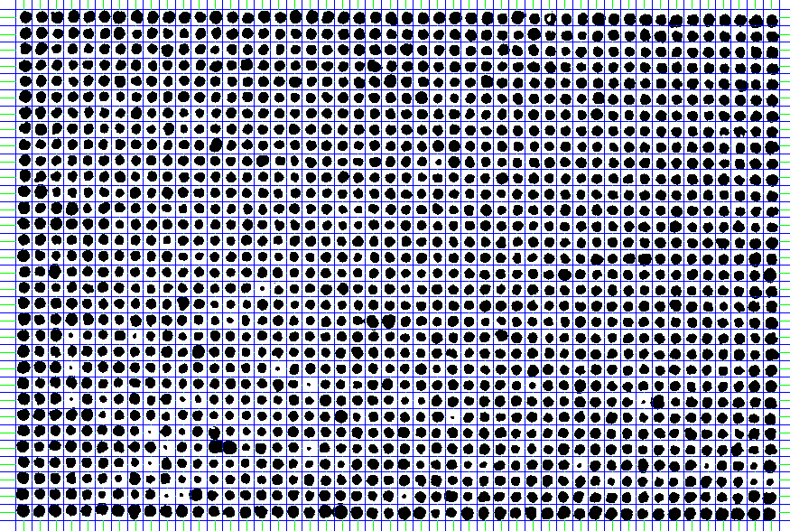
Final Re-clustering
Notes:
Once we have the grid generated we re-cluster each grid box to obtain intensity values

Slide 12
Numbers
Now generate for each color channel:
Mean - size
Median - intensity
Stdev
For each object, by only summing pixels within the detectable ‘colony’ or by taking the entire grid ‘box’ as a whole.
Notes:
We use the median intensity red channel data and size

Slide 13
Black vs White BG
We were able to generate a grid on 100% of black background images
The white background images provided a better false positive and false negative rate because, it is easier to distinguish blue colonies from a white background.
However SpotOn was not able to process 100% of white background images.

Slide 14
Manual Grid
Spot-On is not able to generate a grid on 10% of white BG images.
Not enough colonies visible on a plate
Too many different types of colonies on a plate

Slide 15
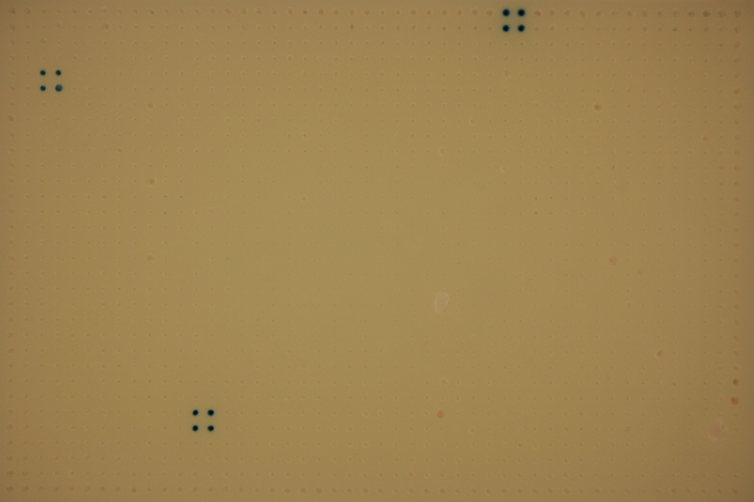
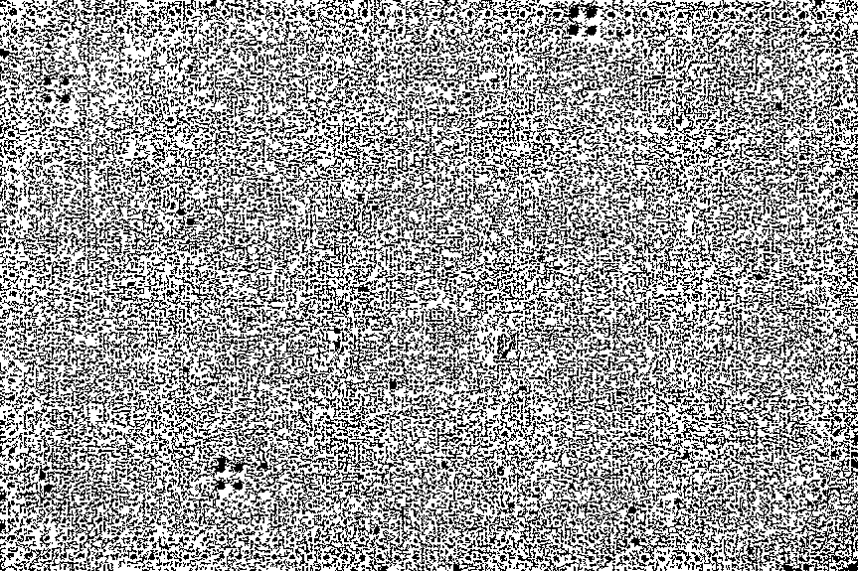
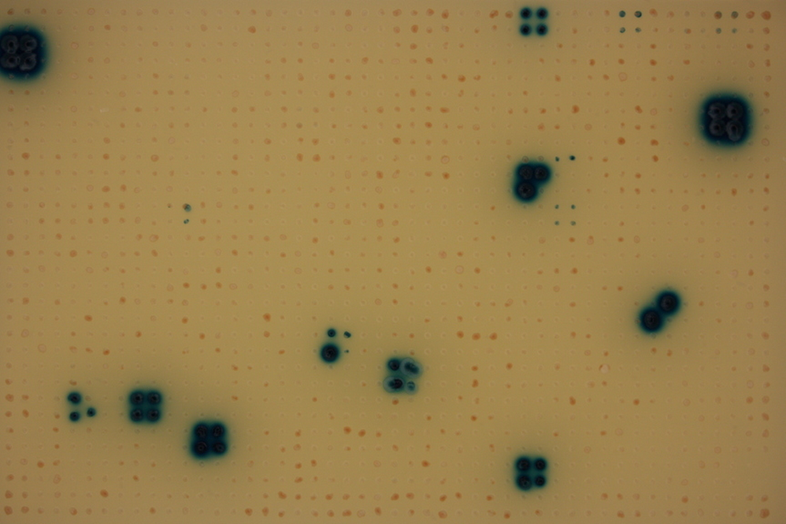
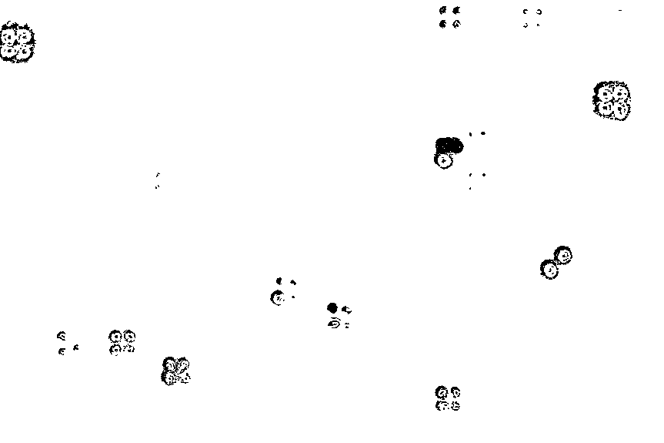
Examples of Plates with issues
EA_E07 1-4
Computer :EA_E07 1-4
Y1H_010 1-4
Computer : Y1H_010 1-4

Slide 16
Manual grid program
MatLab program that allows the user to define the position of the grid
The user clicks on the top right and left colonies on a plate

Slide 17
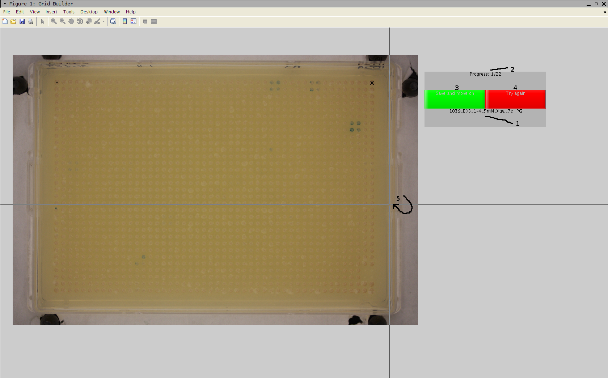
Manual grid solution

Slide 18
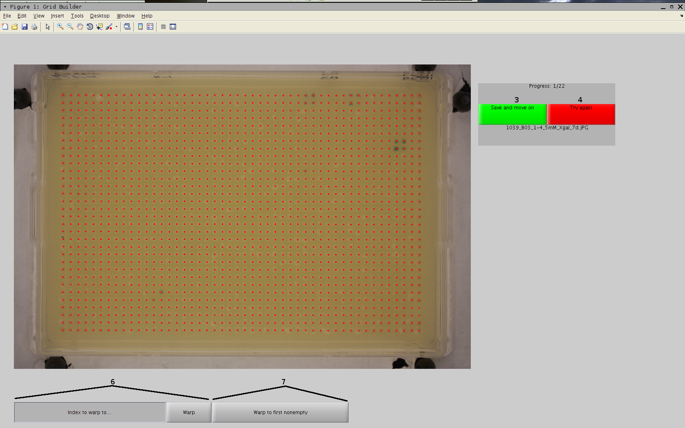
Manual grid solution

Slide 19
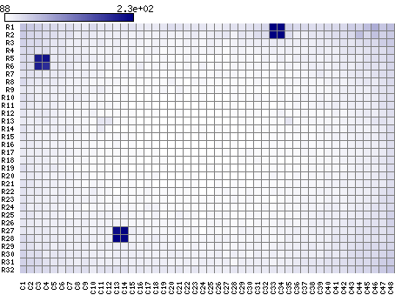
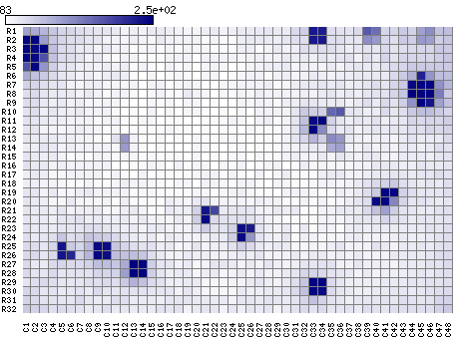
Results using Manual Grid
EA_E07 1-4
Computer :EA_E07 1-4
Y1H_010 1-4
Computer : Y1H_010 1-4

Slide 20
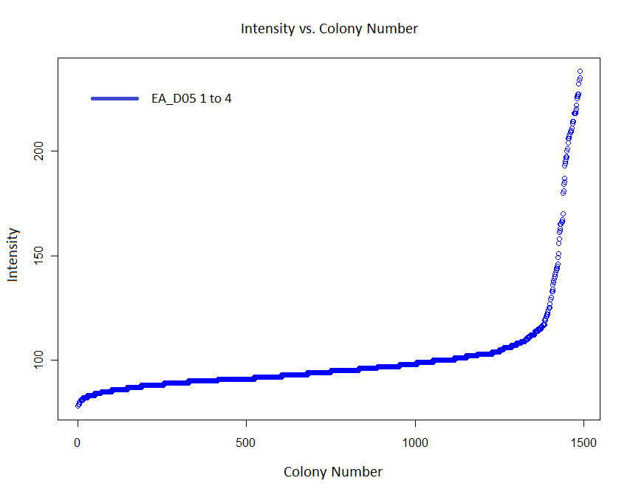
How do you pick a cut off for positives?
Calling positive colonies
I.E. Colonies with a intensity value significantly different to the background.
How should the cut off be calculated.
Different baits with different backgrounds may have a different cut off.
Notes:
Put the image from the paper in the place of the image that was there

Slide 21
Analysis of the Data and correction methods
Penalize smallest 1.1% of colonies
Common false positives with black background
Normalization
Border colonies were common false positives
1st Z-Score
Remove outliers to generate true average&stdev for negative colonies
2nd pass Z-Score
Use the new average and stdev

Slide 22
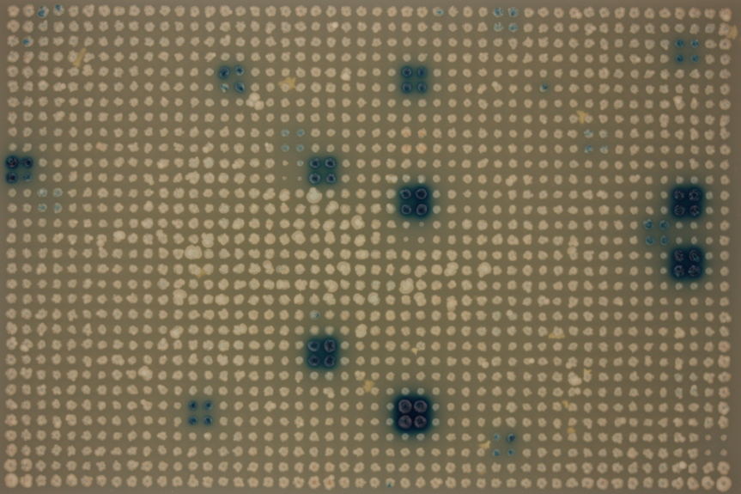
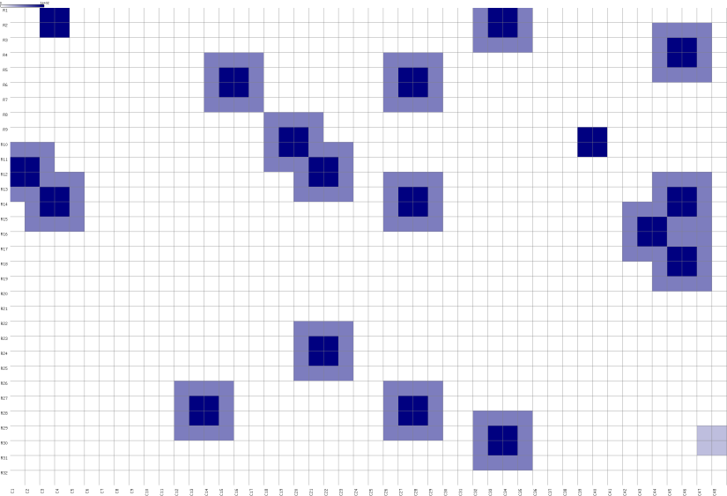
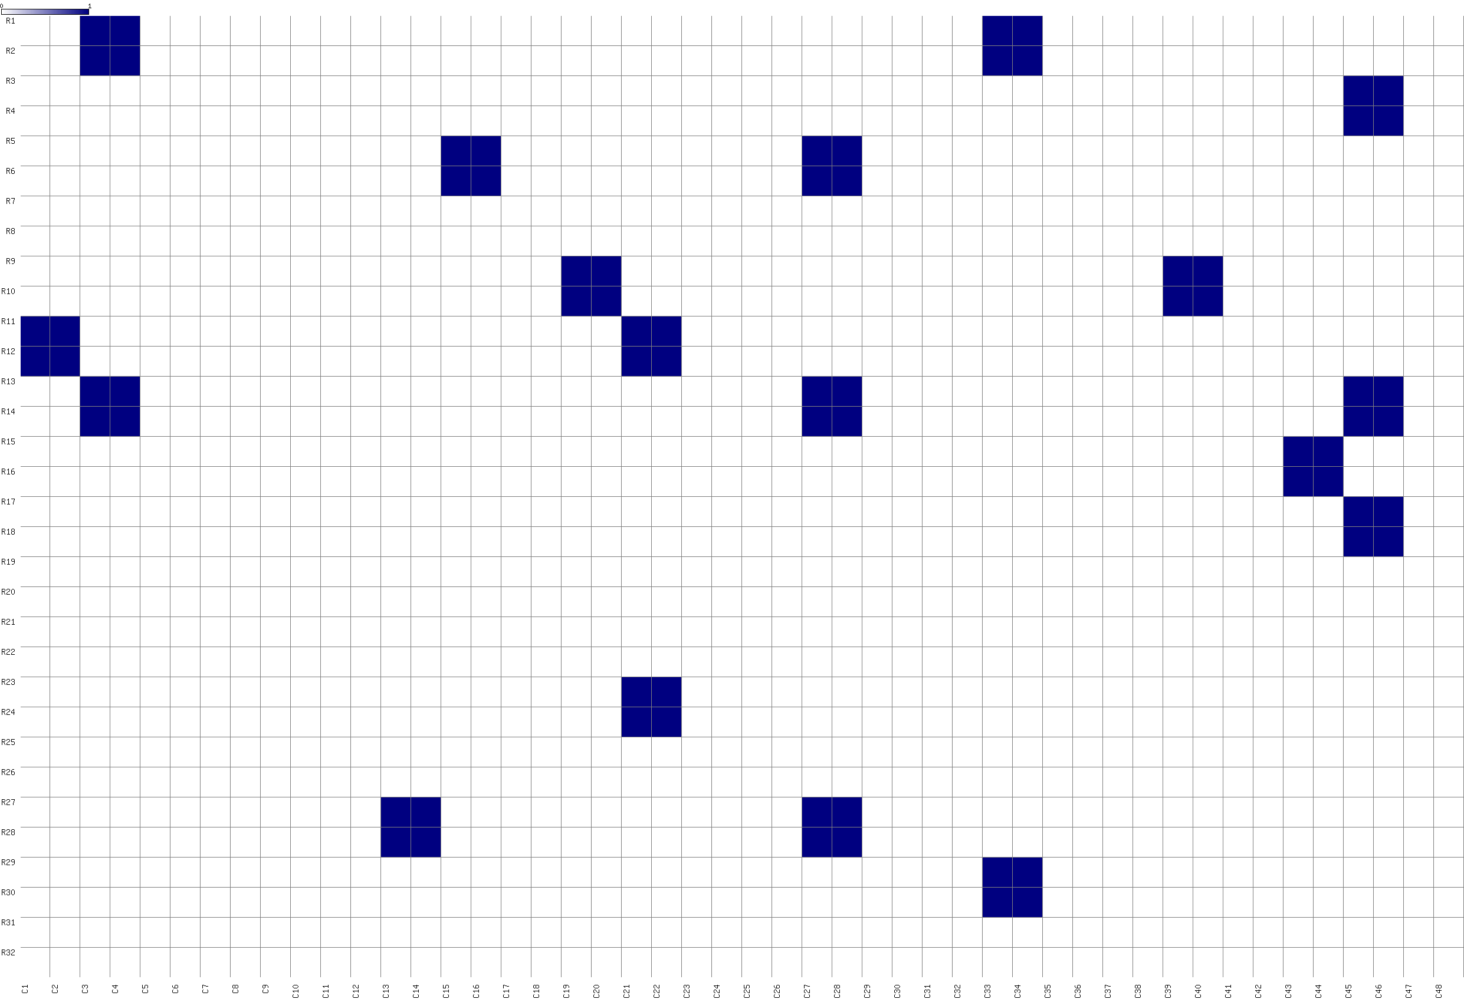
Results
EA_D05_N_1-4
Positives + ignore list + bleed-over
Positives
Notes:
Once we obtained the results some issues came up: Bleed over and empty spots

Slide 23
Bleed-Over + Ignore List
Ignore list
Yeast with empty vector were common false positives
List of these coordinates for the computer to ignore
Bleed-over
Very blue colonies ‘bleed’ into nearby negatives
Ignore neighbors of the strongest positive quads

Slide 24
Optimizing Z-score cutoff
Rank all colonies per plate by Z-score
Determine which TFs have at least 2 positive colonies
Compare computer calls with a human call list
Pick a False Positive rate you are comfortable with

Slide 25
Current status of plates for 1st paper
150 plates processed [50 baits]
Intensity values for black and white background plates.
Now we can benchmark the performance of SpotOn by comparing with manual calls.

Slide 26
FP 5%, FN 34%
Black Background Pictures
FP 5%, FN 18%
White Background Pictures

Slide 27
Current issues
Should we penalize small colonies?
Small colonies should only be a problem with black background images
The next project has 700 baits with varying background
What to do with high background baits

Slide 28
Do we need to apply a penalty
With Penalty
Z= 2.30
FP 5%
FN 18%
Without Penalty
Z= 4.1
FP 5%
FN 18%

Slide 29
High BG Baits
What do you do if the Background level is not low?

Slide 30
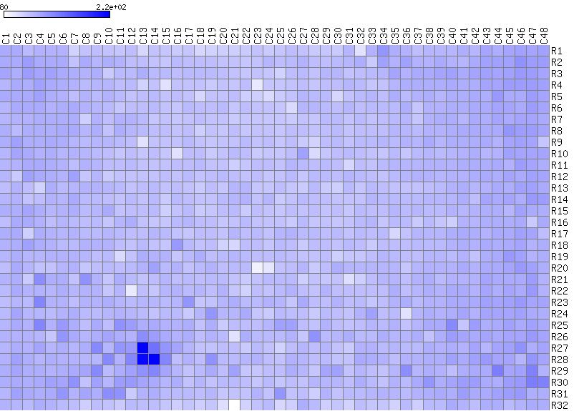
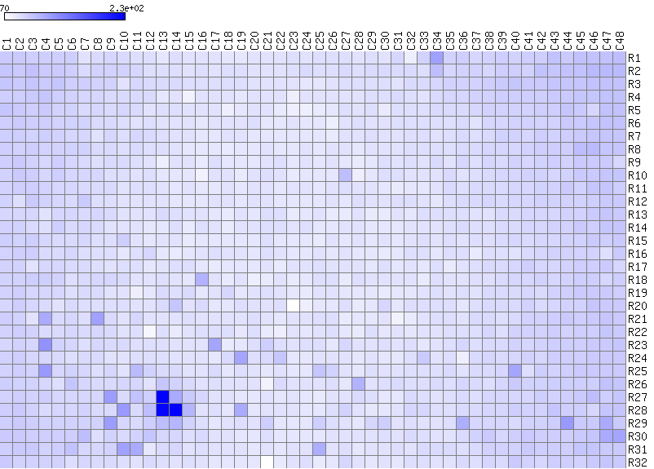
Low Background Bait’s
Original image
Image representation of the output
When only the colony is taken into account the background is ignored and therefore the score for each grid cell is less.
Does this hold up with High Background Baits?
All Box
Colony Only
1006_A06_1-4_5mM_Xgal_7d

Slide 31
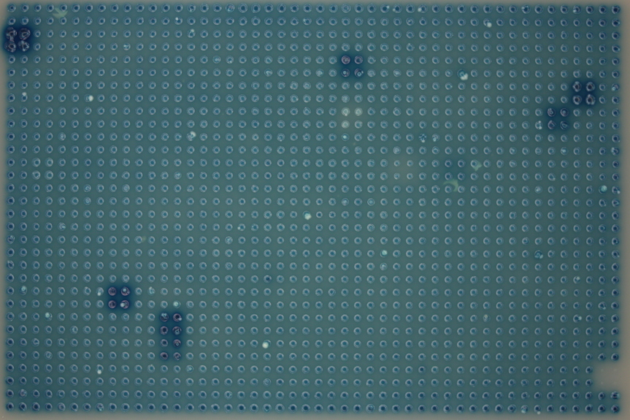
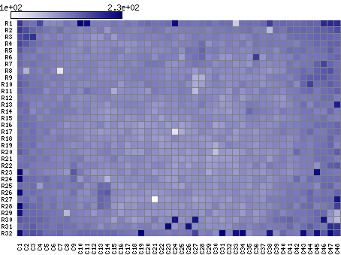
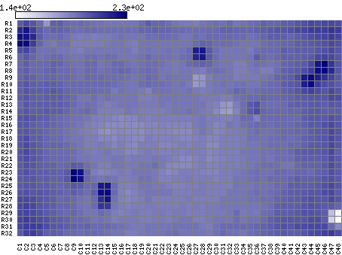
Colonies vs All Pixels with the black background
Examination of all pixels that make up a grid box has shown better results so far.
Colonies within a box
Pixels within a box

Slide 32
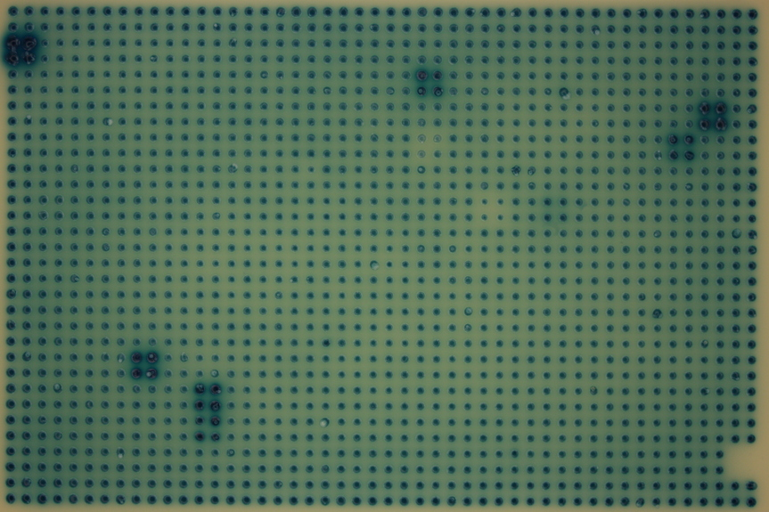
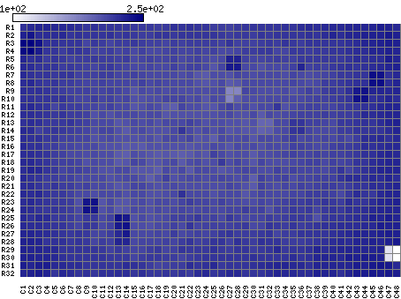
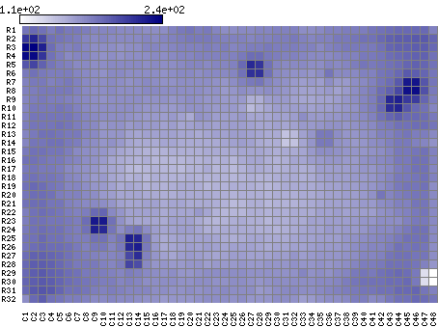
Colonies vs All Pixels with the white background
The colony-only analysis looks okay however using the whole box is better.
Colonies within a grid box
All Pixels within a grid box

Slide 33
Black vs White Background
White Background
Black Background

Slide 34
We need an automated way to determine when to use the whole grid box vs colony
Examine background expression level of all plates
Cluster into 3 groups
Use the whole grid box on plates that are in the high background cluster

Slide 35
Future work
Process all of the plates for the second paper
Automate colony vs whole grid box decision
Look at batch effects
Work on network analysis
Create a tool to allow for easy delivery of images to be processed
Create a tool to allow for quality control

Slide 36
End

Slide 37
Supplemental slides
Normalize how to
Z-score how to
Image Viewer

Slide 38
LIMS Picture Viewer

Slide 39
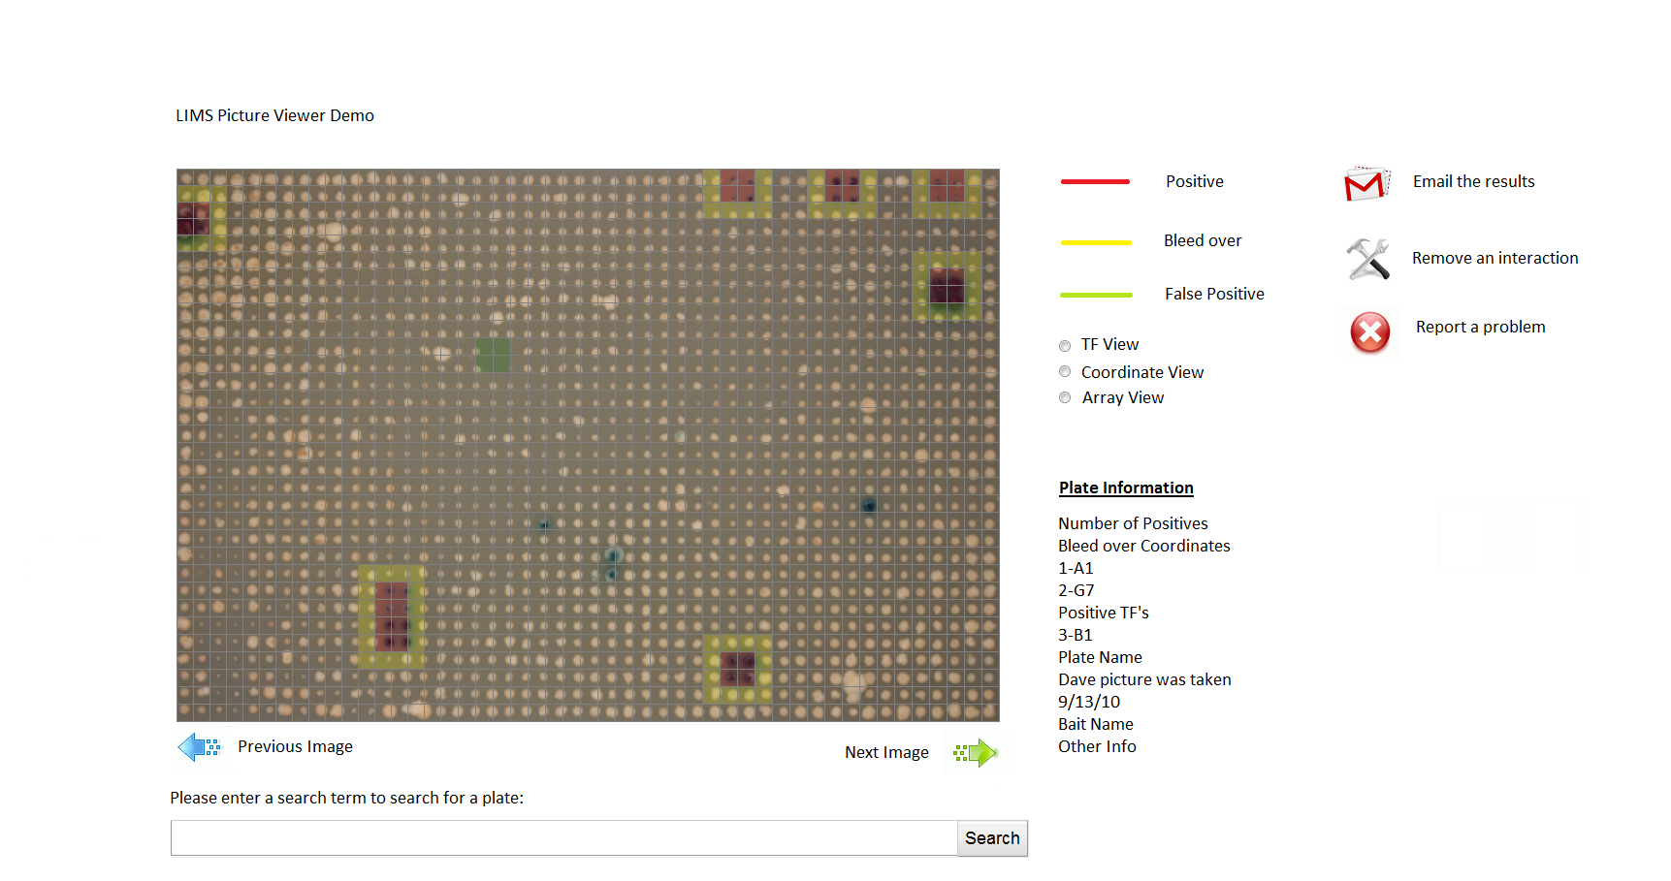
LIMS Picture Viewer Mockup

Slide 40
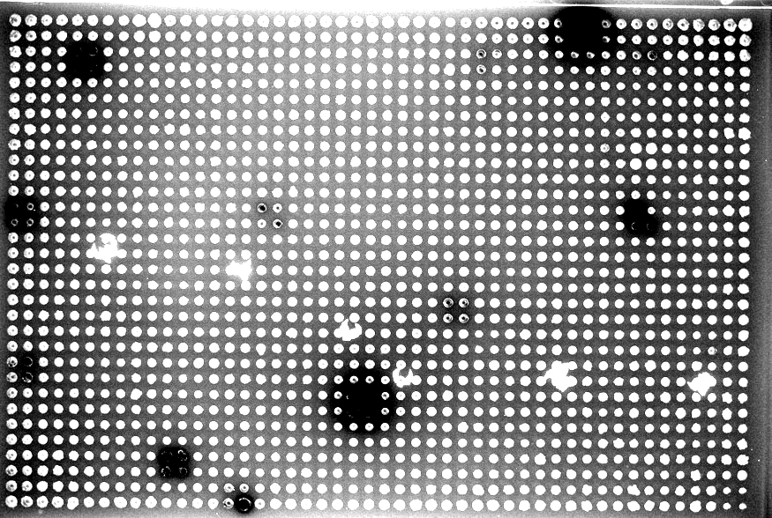
Gradient in agar thickness

Slide 41
Normalization: How to handle agar thickness variations
In many instances the colonies around the borders are darker then colonies in the center of the plate due to the extra agar thickness.
A color gradient is formed.
We normalize the values of the colonies to reduce these affects.

Slide 42
Normalize
Find the median of all rows.
Find the average of all the medians.
For each row median, divide (average of all medians / row median) to obtain the normalization factor.
Multiply all values in each row by the normalization factor.
To obtain a new matrix.
Now do the exact same thing for all columns using the row normalized matrix.

Slide 43
Z-Scores
Z-scores turned into an image matrix
Notes:
Move Z-Score to be next to the second pass Z score

Slide 44
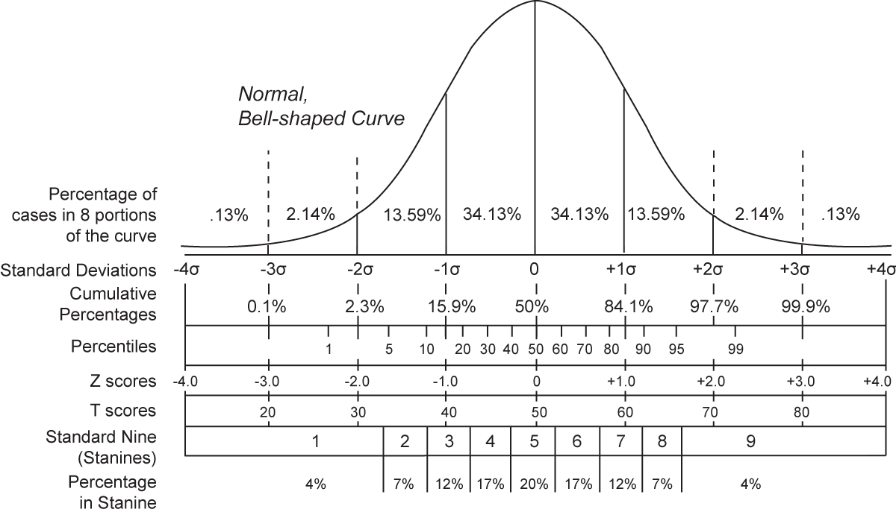
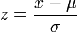
Z-Score
The Z-Score tells you how many Standard Deviations you are away from the mean.
x is a raw score to be standardized;
μ is the mean of the population;
σ is the standard deviation of the population.
Comparing various methods including Z-Score
http://en.wikipedia.org/wiki/Standard_score

Slide 45
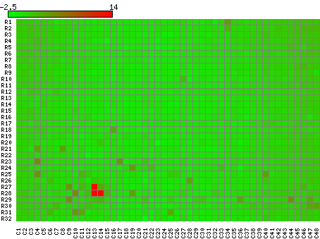
Comparing the Z-score against not taking the Z-Score
This is a matrix of the image formed only using the median values of the blue colonies. 1006_A06_1-4_5mM_Xgal_7d
This is a matrix image formed from the z scores of the median values of the blue colonies. 1006_A06_1-4_5mM_Xgal_7d

Slide 46
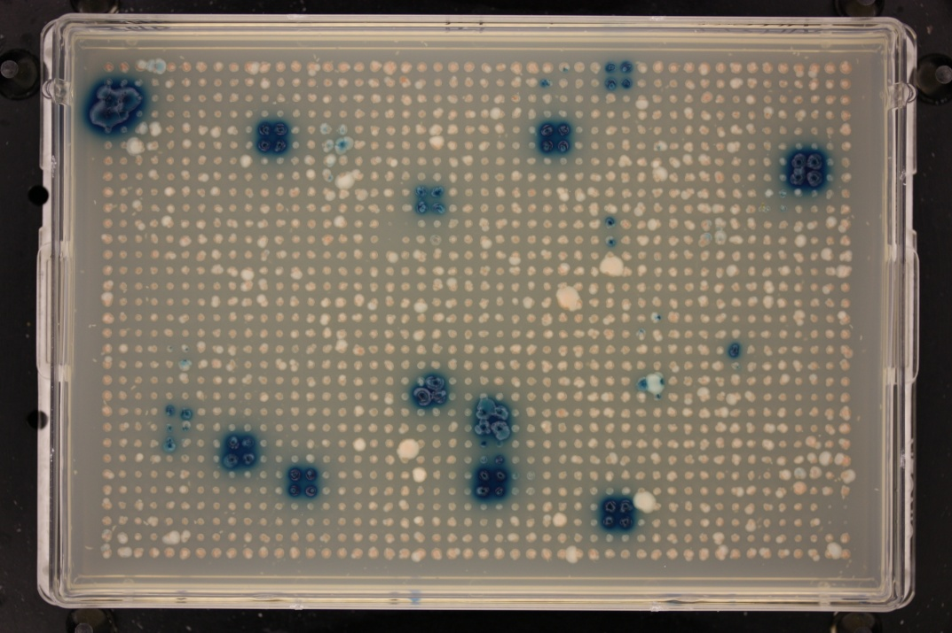
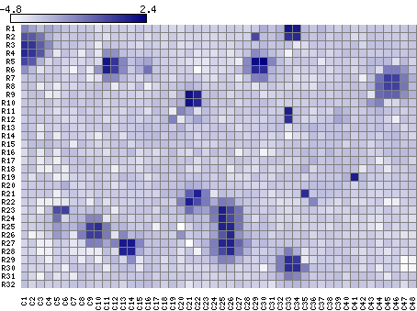
Y1H_066_N_1-4_5mM_Xgal_7d_B
Z-Score of Intensity Values
Notes:
A good Z Score cut off would be 2 however in this case if we used 2 as the cut off we would loose too many of the positive colonies

Slide 47
Using the Z-Score to create the mean and Standard Deviation for a new Z-Score

Slide 48
What problems are we trying to solve
Normally people take a Z-Score cut off of 2.
When we generate the Z-Score values the high intensity values throw off the mean and Standard Deviation causing the cut off to be too low to retain a good number of positives.

Slide 49
2nd pass Z-Score
Generate a Z-Score value for every colony, then use those values as a cut off for obtaining the mean and standard deviation for the second Z-Score.
We took a cut off of 2
This means that any intensity value with a corresponding Z-Score less then 2 would be used to calculate the mean and standard deviation.
Once we had that we could generate a Z-Score for each colony using the lower mean and standard deviation values.
This allows for “we hope” weaker positives to show up in our final list.

Slide 50
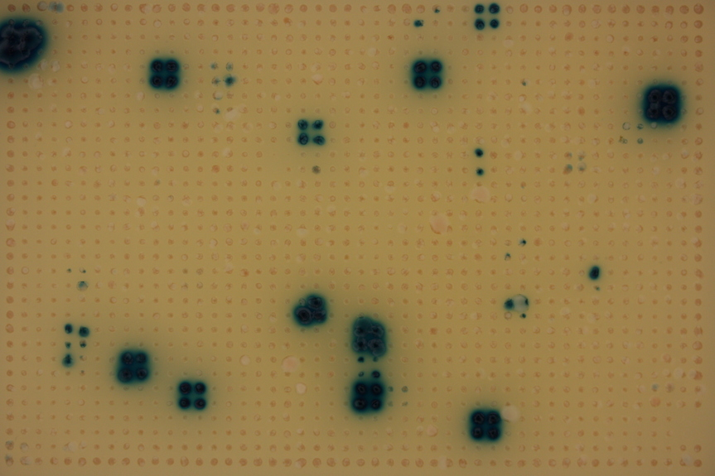
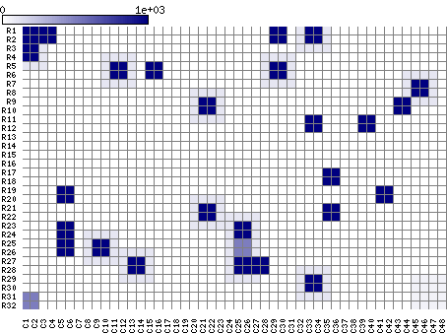
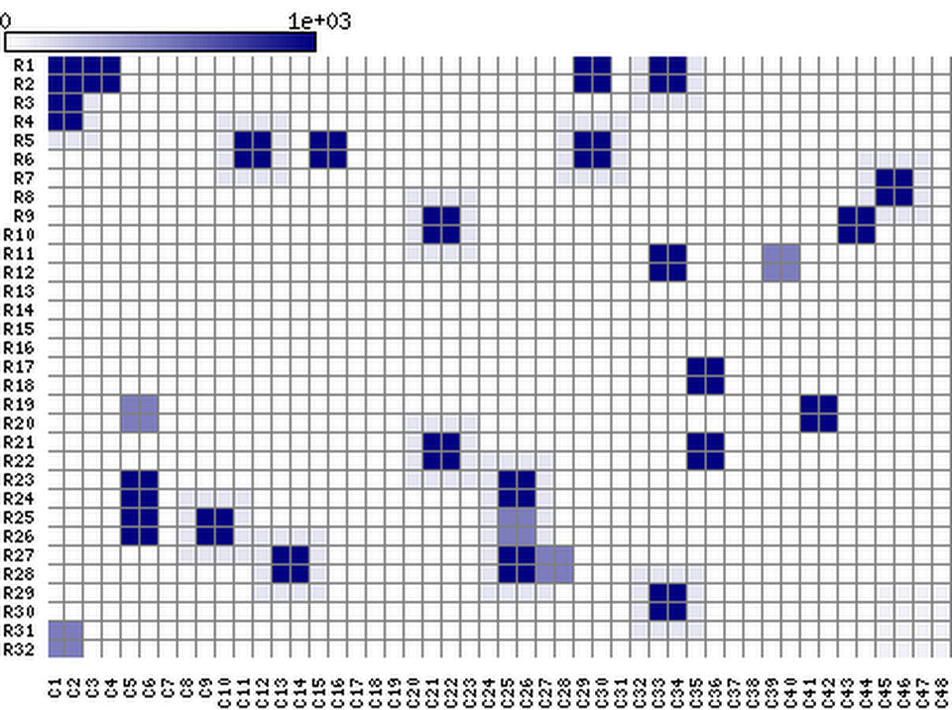
Original
Non Penalty
Penalty

